Slide 1

Financial Markets
(FIN 350)
Academic year 2023-2024

Slide 2
Outline
What does the top-down strategy consist of
Why did we choose it
How did we proceed when choosing the stocks

Slide 3
What is top-down strategy
In a nutshell, the top-down strategy when choosing stocks is all about starting with the big picture and zooming in from there. Here's how it works:
1. Macroeconomic analysis: we begun by examining the overall state of the economy, considering factors like GDP, interest rates, inflation, and global trends. This helped us understand the general direction of the market and identify promising sectors.
2. Sector selection: Based on the macroeconomic analysis, we then focused on specific sectors that stand to benefit from current or predicted economic conditions.
3. Company selection: Within the chosen sector, we analyzed individual companies by looking at financial ratios, and seeing the overall performance

Slide 4
Why did we choose to do it
Reduced risk: By understanding the macro environment, we avoided sectors vulnerable to external forces.
Portfolio diversification: ensuring your portfolio isn't overly concentrated in one area.
Efficiency: It can save time and effort by focusing on promising sectors instead of analyzing every individual stock.

Slide 5
Major steps when performing top-down strategy
Step 1 : analysing the industry average returns for the past 10 years accoridng to the gdp growth, interest rates, and inflation rates during the past 10 years
Step 2 : choosing the industries
Step 3 : performing growth analysis on the stocks
Step 4 : checking past performance, ratio analysis, and looking for the trends via technical analysis
Step 5 :determining the entry point

Slide 6
how are the stocks classified ?
COMPOSITION DES INDICES SECTORIELS / COMPONENTS OF THE SECTOR INDICES /عناصر المؤشرات القطاعية
المؤشر / INDICE | SOCIETE / COMPANY NAME | MNEMO / TICKER
TECHNOLOGIE / TECHNOLOGY / تكنولوجيا
TECHNOLOGIE / TECHNOLOGY / تكنولوجيا | TELNET HOLDING | TLNET
 | AE TECH | AETEC
SOCIETES FINANCIERES / FINANCIALS / المـــالية
BANQUES / BANKS / البنوك | BANQUE DE TUNISIE ET DES EMIRATS (ADP) | BTE
 | ATTIJARI BANK | TJARI
 | BANQUE INTERNATIONALE ARABE DE TUNISIE | BIAT
 | BH BANK | BH
 | BANQUE DE TUNISIE | BT
 | UNION BANCAIRE POUR LE COMMERCE ET L'INDUSTRIE | UBCI
 | SOCIETE TUNISIENNE DE BANQUE | STB
 | BANQUE NATIONALE AGRICOLE | BNA
 | AMEN BANK | AB
 | ARAB TUNISIAN BANK | ATB
 | UNION INTERNATIONALE DE BANQUES | UIB
 | WIFACK INTERNATIONAL BANK | WIFAK
ASSURANCE / INSURANCE / التأمين | COMPAGNIE D'ASSURANCES ET DE REASSURANCES | AST
 | SOCIETE TUNISIENNE D'ASSURANCES ET DE REASSURANCES | STAR
 | BH ASSURANCE | BHASS
 | SOCIETE TUNISIENNE DE REASSURANCE | TRE
 | ASSURANCES MAGHREBIA | ASSMA
 | ASSURANCES MAGHREBIA VIE | AMV

Slide 7
SERVICES FINANCIERS / FINANCIAL SERVICES / الخدمات المالية | SPDIT - SICAF | SPDIT
 | TUNISIE LEASING ET FACTORING | TLS
 | PLACEMENT DE TUNISIE-SICAF | PLTU
 | TUNINVEST-SICAR | TINV
 | COMPAGNIE INTERNATIONALE DE LEASING | CIL
 | ARAB TUNISIAN LEASE | ATL
 | ATTIJARI LEASING | TJL
 | BH LEASING | BHL
 | HANNIBAL LEASE | HL
 | BEST LEASE | BL
TELECOMMUNICATIONS / TELECOMMUNICATIONS / االتصـــاالت
TELECOMMUNICATIONS / TELECOMMUNICATIONS / االتصـــاالت | SOTETEL | SOTET
 | TAWASOL GROUP HOLDING | TGH
SERVICES AUX CONSOMMATEURS / CONSUMER SERVICES / الخدمــات للمستھلك
DISTRIBUTION / GENERAL RETAILERS / التوزيع | MONOPRIX | MNP
 | MAGASIN GENERAL | MAG
 | SOTUMAG | MGR
 | AUTOMOBILE RESEAU TUNISIEN ET SERVICES | ARTES
 | ENNAKL AUTOMOBILES | NAKL
 | CITY CARS | CITY
 | CELLCOM | CELL
 | SMART TUNISIE | SMART
 | SOCIETE TUNISIENNE D'AUTOMOBILES | STA
SANTE / HEALTH CARE / الصحـة
SANTE / HEALTH CARE / الصحـة | UNIMED | UMED

Slide 8
BIENS DE CONSOMMATION / CONSUMER GOODS / مــواد االستھالك
AUTOMOBILES ET EQUIPEMENTIERS / AUTOMOBILES & PARTS / تجھيزات السيارات | SOCIETE TUNISIENNE DES INDUSTRIES PNEUMATIQUES | STIP
 | SOCIETE L'ACCUMULATEUR TUNISIEN | ASSAD
صناعة األغذية الفالحية و المشروبات/ AGRO-ALIMENTAIRE ET BOISSONS / FOOD & BEVERAGE | SOCIETE DE FABRICATION DES BOISSONS DE TUNISIE | SFBT
 | POULINA GP HOLDING | PGH
 | LAND'OR | LNDOR
 | DELICE HOLDING | DH
PRODUITS MENAGERS ET DE SOIN PERSONNEL / PERSONAL & HOUSEHOLD GOODS / التجھيزات المنزلية | NEW BODY LINE | NBL
 | EURO-CYCLES | ECYCL
 | SOCIETE D'ARTICLES HYGIENIQUES | SAH
 | OFFICEPLAST | PLAST
 | ATELIER DU MEUBLE INTERIEURS | SAM
INDUSTRIES / INDUSTRIALS / الصنــــاعة
BATIMENT ET MATERIAUX DE CONSTRUCTION / CONSTRUCTION & MATERIALS / المقاوالت و مواد البناء | SOCIETE IMMOBILIERE ET DE PARTICIPATION | SIMPA
 | SOCIETE MODERNE DE CERAMIQUE | SOMOC
 | SOCIETE IMMOBILIERE TUNISO-SEOUDIENNE | SITS
 | ESSOUKNA | SOKNA
 | CIMENTS DE BIZERTE | SCB
 | CARTHAGE CEMENT | CC
 | SOTEMAIL | SOTEM
 | MANUFACTURE DE PANNEAUX BOIS DU SUD | MPBS
 | SANIMED | SMD
BIENS ET SERVICES INDUSTRIELS / INDUSTRIAL GOODS & SERVICES / مواد و خدمات الصناعة | SOCIETE TUNISIENNE DE VERRERIES | SOTUV
 | SOCIETE INDUSTRIELLE D'APPAREILLAGE ET DE MATERIELS ELECTRIQUES | SIAME
 | ONE TECH HOLDING | OTH

Slide 9
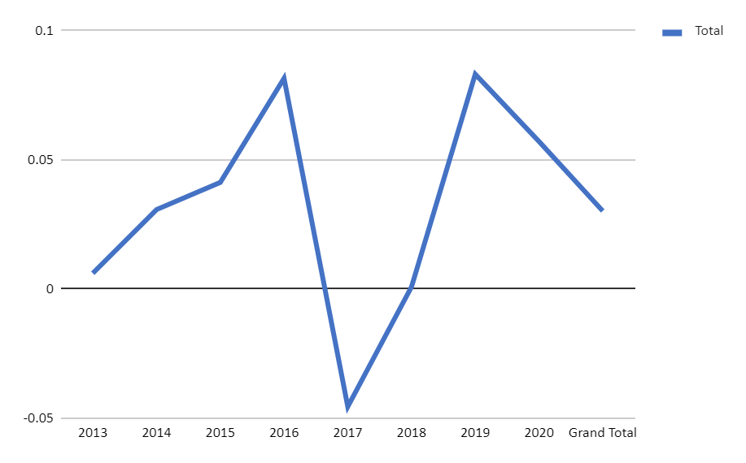
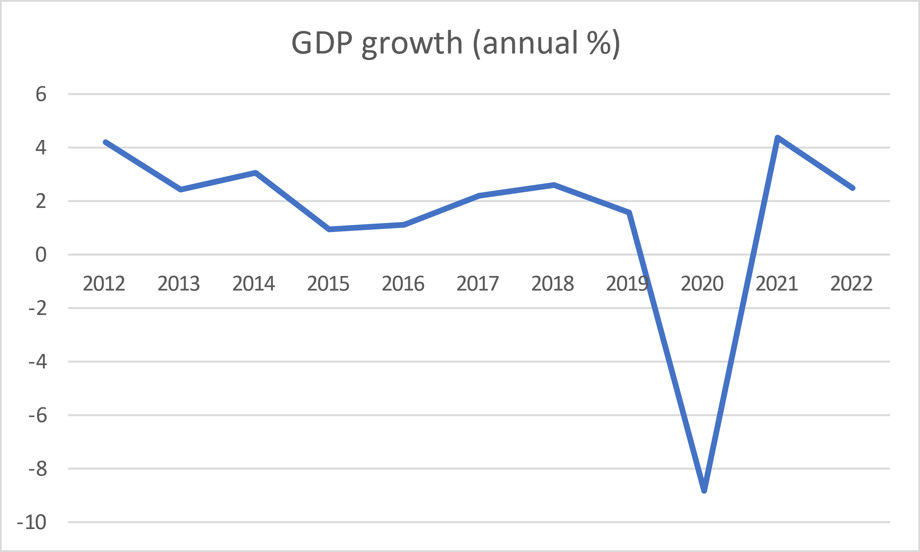
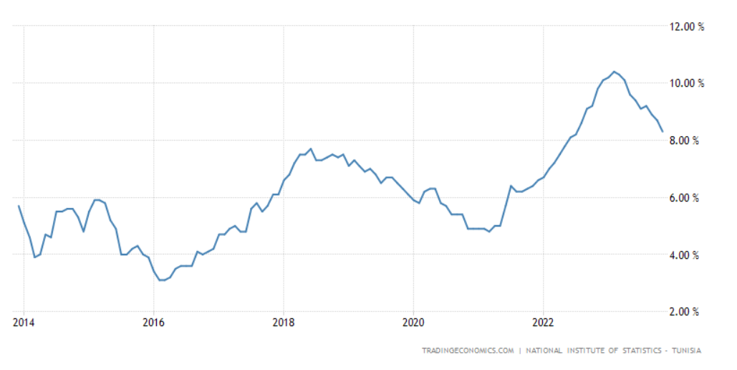
banks
inflation

Slide 10


Slide 11
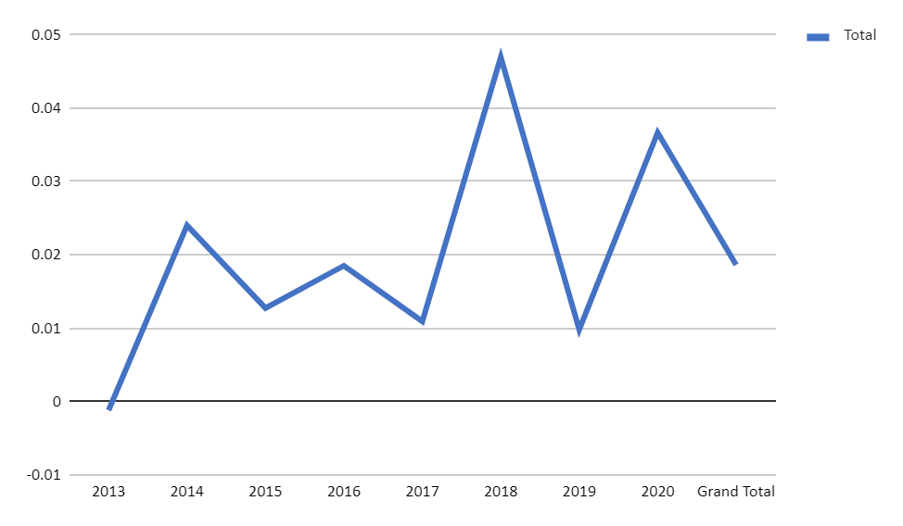
insurance

Slide 12
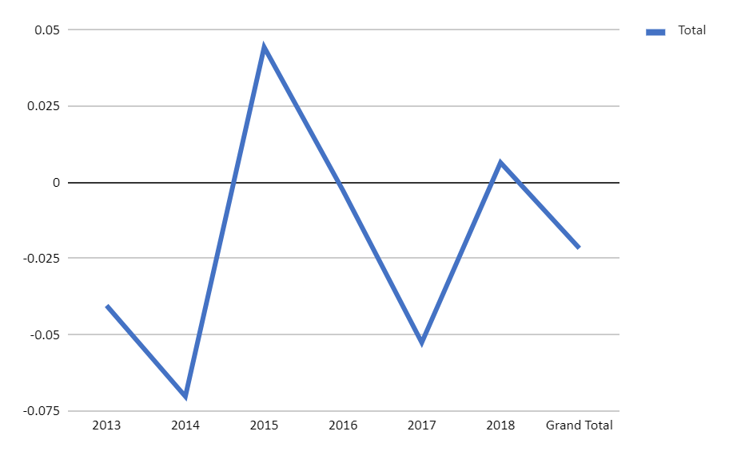
Automobiles and parts

Slide 13
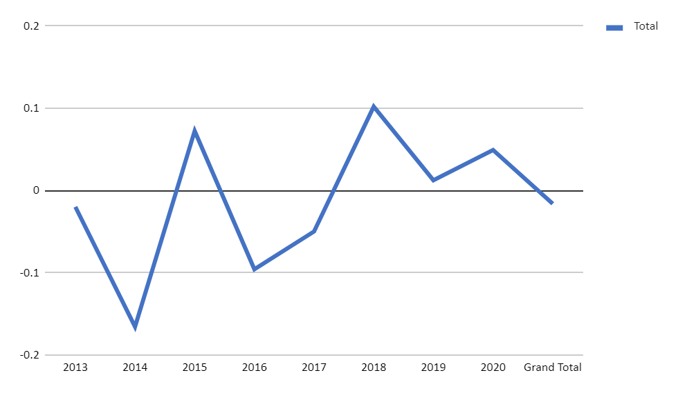
Construction materials

Slide 14
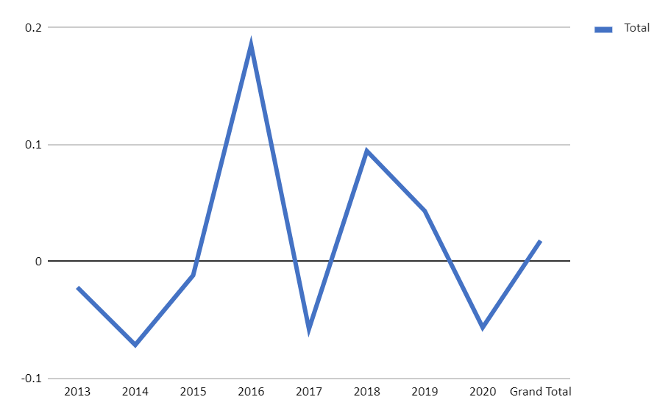
Industrial g&s

Slide 15
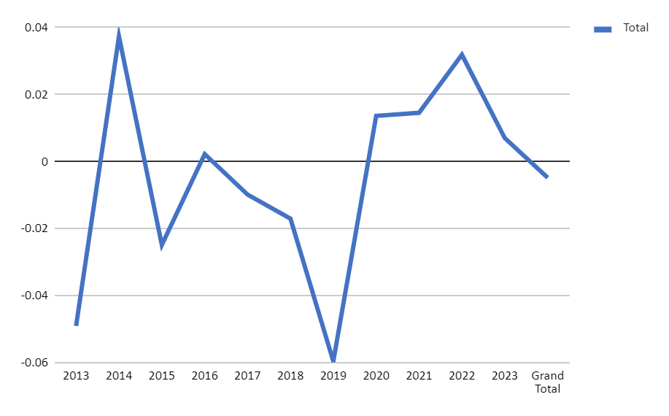
DISTRIBUTION

Slide 16
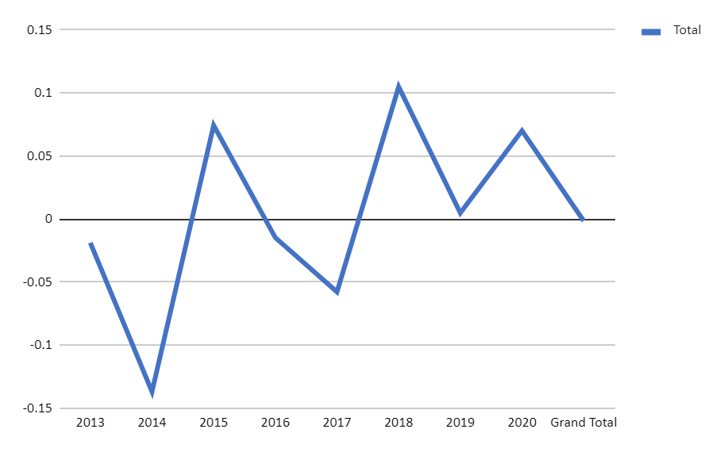
Industrials

Slide 17
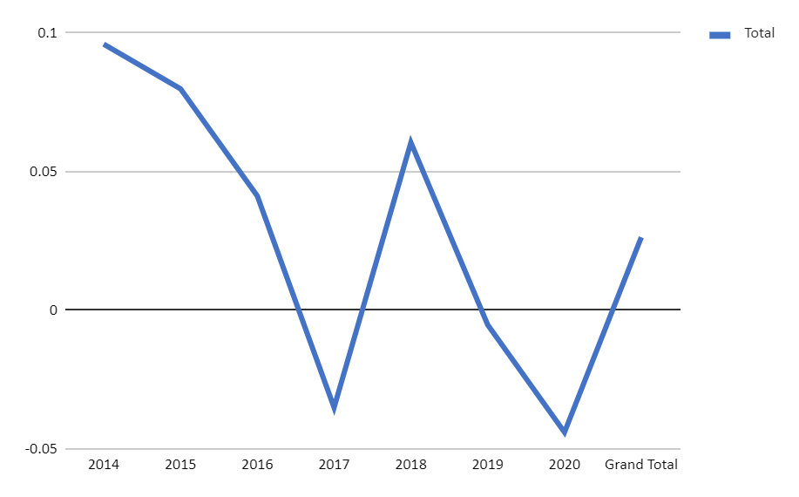
Personal and household goods

Slide 18
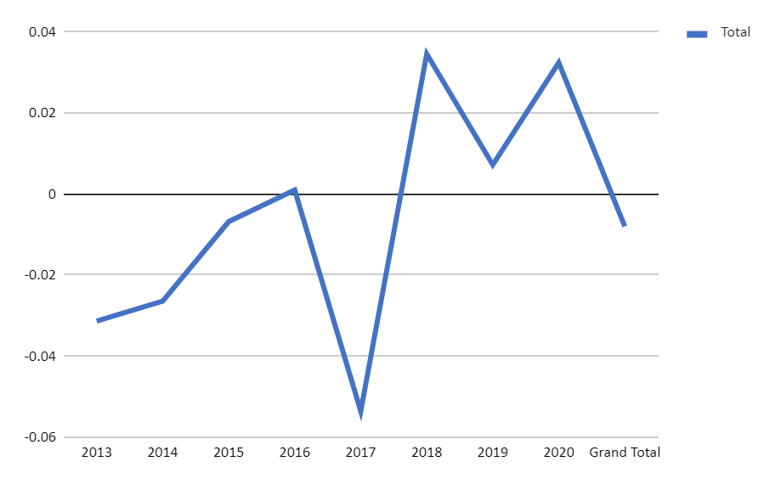
Consumer services

Slide 19
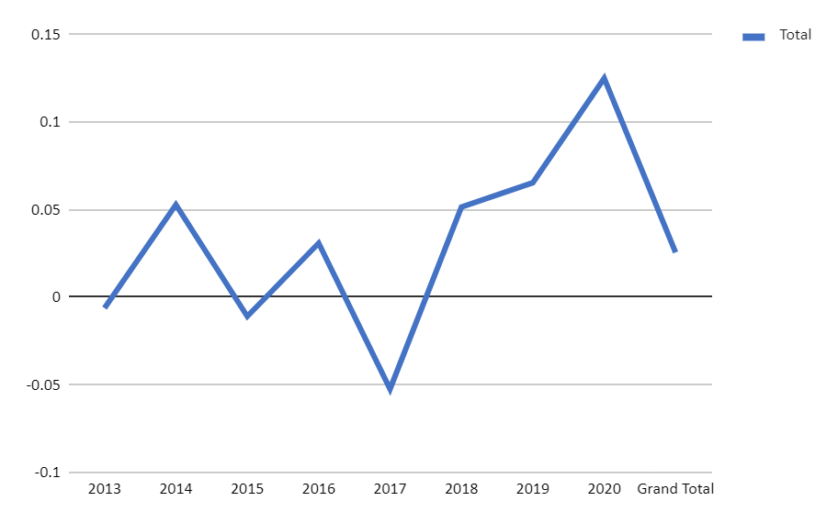
Financial services

Slide 20
the chosen sectors
In addition to how sectors were performing according to gdp growth, we took into consideration the fact that the tunisians are very consuming nations, therefore sectors like food and beverage, and technology are a must have.
Other than food and beverages, and technology, we went with banks, general retailers, health care, industrial good and services, and personal and household goods

Slide 21

Analysing the growth
What were the rates that we chose to analyse growth ?
total assets growth: Shows how fast the company's resources are expanding.
Total liabilities growth: Reveals how quickly the company's debt pile is increasing.
Sales growth: Tracks how fast the company's top-line revenue is climbing.
Operating income growth: Measures how efficiently the company generates profit before taxes and financing.
Net income growth: Shows the bottom-line profit increase after all expenses and taxes.
EPS growth: Tells you how quickly the company's earnings per share are rising, impacting potential share price appreciation.

Slide 26

Streamlining Choices for In-Depth Fundamental Analysis
Following a comprehensive analysis, we successfully whittled down the pool of 36 stocks to a more manageable selection of 23.
The remaining stocks in consideration are Aetech, Amen Bank, AMV, BH ASSURANCE, BH BANK, BIAT, BTE, DH, ENNAKL, EUROCYCLE, MG, MONOPRIX, OFFICE PLAST, SAH, OTH, SFBT, SMART TN, SOTUMAG, TUNS RE, UBCI, UIB, UNIMED, and WIFAK.
This reduction has significantly streamlined our focus, paving the way for a more in-depth fundamental analysis. Leveraging a variety of analytical techniques, we are poised to delve into both quantitative aspects, examining numerical data, and qualitative dimensions, utilizing visualizations. This refined list empowers us to conduct a thorough assessment of each stock's potential, facilitating a more informed and strategic decision-making process.

Slide 27
Next, MORE RATIOS
LIQUIDITY RATIO
Current Ratio
Quick Ratio
Cash Ratio
ACITVITY RATIO
receivable turnover
average receivables collection day
Inventory turnover
avg days inventory in stock
payables turnover
avg days payables outstanding
op cycle
ccc
asset turnover
fixed asset turnover
PROFITABILITY RATIO
ROE
ROA
Gross PM on sale
Operating Margin
net PM on sale
EPS
P/E
div payout
div yield
SOLVENCY RATIO
DEBT on TA
DEBT to eq
financial leverage
TIE
BASED ON THE Z SHARES WE CHOSE WE PERFORMED EVEN MORE IN DEPTH ANALYSIS BASED ON DIFFERENT TYPES OF RATIOS
WHERE WE WILL GET THE 12 STOCKS

Slide 28
Banks
Amen
Attijari
BH
Industry
P/E Ratio TTM | 6.44
Price to Sales TTM | 2.64
Operating margin TTM | 46.54%
Operating margin 5YA | 46.54%
Pretax margin TTM | 49.20%
Pretax margin 5YA | 47.18%
Net Profit margin TTM | 40.92%
Net Profit margin 5YA | 41%
Revenue/Share TTM | 12.32
Basic EPS ANN | 5.04
Dividend Yield ANN | 4.10%
Dividend Yield 5 Year Avg. 5YA | 4.69%
Dividend Growth Rate ANN | -59.25%
Payout Ratio TTM | 15.13%
P/E Ratio TTM | 8.33
Price to Sales TTM | 2.67
Operating margin TTM | 48.76%
Operating margin 5YA | 48.91%
Pretax margin TTM | 46.70%
Pretax margin 5YA | 46.40%
Net Profit margin TTM | 32.06%
Net Profit margin 5YA | 32.56%
Revenue/Share TTM | 16.1
Basic EPS ANN | 4.82
Dividend Yield ANN | 9.38%
Dividend Yield 5 Year Avg. 5YA | 6.81%
Dividend Growth Rate ANN | 16.67%
Payout Ratio TTM | 77.41%
P/E Ratio TTM | 4.49
Price to Sales TTM | 1.14
Operating margin TTM | 45.75%
Operating margin 5YA | 49.11%
Pretax margin TTM | 43.02%
Pretax margin 5YA | 45.62%
Net Profit margin TTM | 25.30%
Net Profit margin 5YA | 30.28%
Revenue/Share TTM | 10.39
Basic EPS ANN | 2.63
Dividend Yield ANN | 7.47%
Dividend Yield 5 Year Avg. 5YA | 5.06%
Dividend Growth Rate ANN | 50%
Payout Ratio TTM | 36.13%
P/E Ratio TTM | 8.78
Price to Sales TTM | 2.55
Operating margin TTM | 48.33
Operating margin 5YA | 46.06
Pretax margin TTM | 47.73
Pretax margin 5YA | 44.15
Net Profit margin TTM | 30.43
Net Profit margin 5YA | 30.91
Revenue/Share TTM | 15.43
Basic EPS ANN | 4.43
Dividend Yield ANN | 5.13
Dividend Yield 5 Year Avg. 5YA | 4.14
Dividend Growth Rate ANN | 7.8
Payout Ratio TTM | 46.8

Slide 29
Banks
BIAT
UBCI
BTE
Industry
P/E Ratio TTM | 10.31
Price to Sales TTM | 3.06
Operating margin TTM | 53.07%
Operating margin 5YA | 51.01%
Pretax margin TTM | 52.96%
Pretax margin 5YA | 49.59%
Net Profit margin TTM | 29.67%
Net Profit margin 5YA | 35.99%
Revenue/Share TTM | 29.49
Basic EPS ANN | 8.75
Dividend Yield ANN | 4.84%
Dividend Yield 5 Year Avg. 5YA | 4.27%
Dividend Growth Rate ANN | 16%
Payout Ratio TTM | 62.72%
P/E Ratio TTM | 7.65
Price to Sales TTM | 1.54
Operating margin TTM | 30.69%
Operating margin 5YA | 32.45%
Pretax margin TTM | 30.85%
Pretax margin 5YA | 31.32%
Net Profit margin TTM | 20.15%
Net Profit margin 5YA | 19.61%
Revenue/Share TTM | 14.17
Basic EPS ANN | 2.99
Dividend Yield ANN | 0.91%
Dividend Yield 5 Year Avg. 5YA | 2.50%
Dividend Growth Rate ANN | -44%
Payout Ratio TTM | 44.37%
P/E Ratio TTM | 6.54
Price to Sales TTM | 1.9
Operating margin TTM | 47.23%
Operating margin 5YA | 43.40%
Pretax margin TTM | 47.12%
Pretax margin 5YA | 40.96%
Net Profit margin TTM | 28.96%
Net Profit margin 5YA | 24.66%
Revenue/Share TTM | 13.24
Basic EPS ANN | 3.84
Dividend Yield ANN | 3%
Dividend Yield 5 Year Avg. 5YA | 2.78%
Dividend Growth Rate ANN | 14.29%
Payout Ratio TTM | 18.26%
P/E Ratio TTM | 8.78
Price to Sales TTM | 2.55
Operating margin TTM | 48.33
Operating margin 5YA | 46.06
Pretax margin TTM | 47.73
Pretax margin 5YA | 44.15
Net Profit margin TTM | 30.43
Net Profit margin 5YA | 30.91
Revenue/Share TTM | 15.43
Basic EPS ANN | 4.43
Dividend Yield ANN | 5.13
Dividend Yield 5 Year Avg. 5YA | 4.14
Dividend Growth Rate ANN | 7.8
Payout Ratio TTM | 46.8

Slide 30
Banks
Wifack
Industry
P/E Ratio TTM | 40.22
Price to Sales TTM | 4.64
Operating margin TTM | 11.76%
Operating margin 5YA | -45.65%
Pretax margin TTM | 12.32%
Pretax margin 5YA | -45.59%
Net Profit margin TTM | 11.53%
Net Profit margin 5YA | -45.73%
Revenue/Share TTM | 1.83
Basic EPS ANN | 0.21
P/E Ratio TTM | 8.78
Price to Sales TTM | 2.55
Operating margin TTM | 48.33
Operating margin 5YA | 46.06
Pretax margin TTM | 47.73
Pretax margin 5YA | 44.15
Net Profit margin TTM | 30.43
Net Profit margin 5YA | 30.91
Revenue/Share TTM | 15.43
Basic EPS ANN | 4.43

Slide 31
Consumer goods
Delice holding
SFBT
Industry
P/E Ratio TTM | 6.88
Price to Sales TTM | 0.49
Operating margin TTM | 8.53%
Operating margin 5YA | 7.17%
Pretax margin TTM | 8.31%
Pretax margin 5YA | 6.72%
Net Profit margin TTM | 7.16%
Net Profit margin 5YA | 5.84%
Revenue/Share TTM | 23.32
Basic EPS ANN | 1.43
Quick Ratio MRQ | 0.33
Current Ratio MRQ | 1.81
Asset Turnover TTM | 2.11
Receivable Turnover TTM | 1.68
Dividend Yield ANN | 2.96%
Dividend Yield 5 Year Avg. 5YA | 3.12%
Payout Ratio TTM | 27.50%
P/E Ratio TTM | 11.56
Price to Sales TTM | 2.23
Operating margin TTM | 22.97%
Operating margin 5YA | 22.60%
Pretax margin TTM | 24.93%
Pretax margin 5YA | 23.55%
Net Profit margin TTM | 19.26%
Net Profit margin 5YA | 18.96%
Revenue/Share TTM | 5.39
Basic EPS ANN | 1.04
Quick Ratio | 3.22
Current Ratio | 3.72
Asset turnover | 0.7082
Receivable turnover | 7.26776
Dividend Yield ANN | 5.58%
Dividend Yield 5 Year Avg. 5YA | 4.18%
Payout Ratio TTM | 68.98%
P/E Ratio TTM | 13.7
Price to Sales TTM | 0.44
Operating margin TTM | 8.66
Operating margin 5YA | 8.36
Pretax margin TTM | 4.59
Pretax margin 5YA | 5.28
Net Profit margin TTM | 3.44
Net Profit margin 5YA | 4.58
Revenue/Share TTM | 19.16
Basic EPS ANN | 0.4
Quick Ratio MRQ | 0.61
Current Ratio MRQ | 1.55
Asset Turnover TTM | 1.18
Receivable Turnover TTM | 4.31
Dividend Yield ANN | 3.41
Dividend Yield 5 Year Avg. 5YA | 2.99
Payout Ratio TTM | 7.29

Slide 32
Consumer goods
Eurocycle
New body line
SAH
Industry
P/E Ratio TTM | 16.45
Price to Sales TTM | 1.18
Operating margin TTM | 12.51%
Operating margin 5YA | 15.99%
Pretax margin TTM | 8.18%
Pretax margin 5YA | 14.57%
Net Profit margin TTM | 7.19%
Net Profit margin 5YA | 12.70%
Revenue/Share TTM | 12.62
Basic EPS ANN | 1.7
Quick Ratio MRQ | 0.2
Current Ratio MRQ | 1.29
Asset Turnover TTM | 0.55
Inventory Turnover TTM | 0.54
Receivable Turnover TTM | 3.91
Dividend Yield 5 Year Avg. 5YA | 6.82%
Dividend Growth Rate ANN | 10.23%
Payout Ratio TTM | 110.25%
P/E Ratio TTM | 17.11
Price to Sales TTM | 3.91
Operating margin TTM | 13.17%
Operating margin 5YA | 21.25%
Pretax margin TTM | 26.42%
Pretax margin 5YA | 31.82%
Net Profit margin TTM | 22.82%
Net Profit margin 5YA | 27.45%
Revenue/Share TTM | 1.32
Basic EPS ANN | 0.27
Quick Ratio MRQ | 3.46
Current Ratio MRQ | 4.47
Asset Turnover TTM | 0.39
Inventory Turnover TTM | 0.88
Receivable Turnover TTM | 2.96
Dividend Yield 5 Year Avg. 5YA | 8.47%
Dividend Growth Rate ANN | -100%
Payout Ratio TTM | 166.14%
P/E Ratio TTM | 18.78
Price to Sales TTM | 0.72
Operating margin TTM | 9.31%
Operating margin 5YA | 9.67%
Pretax margin TTM | 4.99%
Pretax margin 5YA | 4.42%
Net Profit margin TTM | 3.82%
Net Profit margin 5YA | 4.12%
Revenue/Share TTM | 10.72
Basic EPS ANN | 0.42
Quick Ratio MRQ | 0.43
Current Ratio MRQ | 1.09
Asset Turnover TTM | 0.8
Inventory Turnover TTM | 1.74
Receivable Turnover TTM | 3.54
Dividend Yield 5 Year Avg. 5YA | 0.70%
Dividend Growth Rate ANN | -100%
Payout Ratio TTM | 117.26%
P/E Ratio TTM | 10.04
Price to Sales TTM | 2.6
Operating margin TTM | 9.61
Operating margin 5YA | 13.91
Pretax margin TTM | 16.44
Pretax margin 5YA | 19.72
Net Profit margin TTM | 13.97
Net Profit margin 5YA | 16.76
Revenue/Share TTM | 12.93
Basic EPS ANN | -0.27
Quick Ratio MRQ | 2.3
Current Ratio MRQ | 2.98
Asset Turnover TTM | 0.54
Inventory Turnover TTM | 0.59
Receivable Turnover TTM | 1.98
Dividend Yield 5 Year Avg. 5YA | 5.65
Dividend Growth Rate ANN | -66.67
Payout Ratio TTM | 110.34

Slide 33
Distribution
Magasin general
SOTUMAG
Monoprix
Industry
P/E Ratio TTM | -2.57
Price to Sales TTM | 0.09
Operating margin TTM | 0.29%
Operating margin 5YA | 0.77%
Pretax margin TTM | -3.58%
Pretax margin 5YA | -2.92%
Net Profit margin TTM | -3.48%
Net Profit margin 5YA | -2.97%
Revenue/Share TTM | 89.42
Basic EPS ANN | -3.42
Quick Ratio MRQ | 0.21
Current Ratio MRQ | 0.53
Asset Turnover TTM | 1.47
Inventory Turnover TTM | 8.72
Receivable Turnover TTM | 32.36
Dividend Yield 5 Year Avg. 5YA | 0.54%
P/E Ratio TTM | 9.63
Price to Sales TTM | 3.72
Operating margin TTM | 31.52%
Operating margin 5YA | 28.66%
Pretax margin TTM | 46.48%
Pretax margin 5YA | 42.56%
Net Profit margin TTM | 38.63%
Net Profit margin 5YA | 33.98%
Revenue/Share TTM | 1.3
Basic EPS ANN | 0.47
Quick Ratio MRQ | 4.2
Current Ratio MRQ | 4.64
Asset Turnover TTM | 0.44
Inventory Turnover TTM | 18.79
Receivable Turnover TTM | 245.08
Dividend Yield 5 Year Avg. 5YA | 6.63%
Payout Ratio TTM | 162.46%
P/E Ratio TTM | -43.1
Price to Sales TTM | 0.2
Operating margin TTM | 0.91%
Operating margin 5YA | 0.61%
Pretax margin TTM | 0.08%
Pretax margin 5YA | -0.08%
Net Profit margin TTM | -0.45%
Net Profit margin 5YA | -0.62%
Revenue/Share TTM | 33.56
Basic EPS ANN | -0.42
Quick Ratio MRQ | 0.36
Current Ratio MRQ | 0.84
Asset Turnover | 1.65
Inventory Turnover TTM | 17.12
Receivable Turnover TTM | 78.94
Dividend Yield 5 Year Avg. 5YA | 0.20%
Payout Ratio TTM | -73.65%
P/E Ratio TTM | 4.58
Price to Sales TTM | 0.62
Operating margin TTM | 8.77
Operating margin 5YA | 11.37
Pretax margin TTM | 11.28
Pretax margin 5YA | 12.86
Net Profit margin TTM | 7.21
Net Profit margin 5YA | 8.92
Revenue/Share TTM | 6.34
Basic EPS ANN | 0.66
Quick Ratio MRQ | 0.94
Current Ratio MRQ | 1.12
Asset Turnover TTM | 0.6
Inventory Turnover TTM | 0.98
Receivable Turnover TTM | 7.08
Dividend Yield 5 Year Avg. 5YA | 9.61
Payout Ratio TTM | 50.4

Slide 34
Insurances
BH Assurances
Tunis RE
Industry
P/E Ratio TTM | 9.05
Price to Sales TTM | 0.87
Operating margin TTM | 0.131
Operating margin 5YA | 0.1289
Pretax margin TTM | 0.1262
Pretax margin 5YA | 0.125
Net Profit margin TTM | 0.0965
Net Profit margin 5YA | 0.0955
Revenue/Share TTM | 55.84
Basic EPS ANN | 5
Dividend Yield ANN | 2.26%
Dividend Yield 5 Year Avg. 5YA | 2.12%
Dividend Growth Rate ANN | 10%
Payout Ratio TTM | 23.96%
P/E Ratio TTM | 7.45
Price to Sales TTM | 0.7
Operating margin TTM | 9.97%
Operating margin 5YA | 11.56%
Pretax margin TTM | 14.70%
Pretax margin 5YA | 15.05%
Net Profit margin TTM | 9.38%
Net Profit margin 5YA | 12.09%
Revenue/Share TTM | 9.26
Basic EPS ANN | 1
Dividend Yield ANN | 5.34%
Dividend Yield 5 Year Avg. 5YA | 5.13%
Dividend Growth Rate ANN | 42.86%
Payout Ratio TTM | 46.14%
P/E Ratio TTM | 12.35
Price to Sales TTM | 0.88
Operating margin TTM | 10.66
Operating margin 5YA | 9.99
Pretax margin TTM | 10.73
Pretax margin 5YA | 10.33
Net Profit margin TTM | 7.84
Net Profit margin 5YA | 7.66
Revenue/Share TTM | 84.66
Basic EPS ANN | 6.07
Dividend Yield ANN | 2.75
Dividend Yield 5 Year Avg. 5YA | 3.21
Dividend Growth Rate ANN | -19.5
Payout Ratio TTM | 29.61

Slide 35
Health care
Industrials
Tech
UNIMED
One tech holding
Industry
Aetech
Industry
P/E Ratio TTM | 17.81
Price to Sales TTM | 2.03
Operating margin TTM | 19.21%
Operating margin 5YA | 19.58%
Pretax margin TTM | 14.53%
Pretax margin 5YA | 15.46%
Net Profit margin TTM | 11.39%
Net Profit margin 5YA | 12.34%
Revenue/Share TTM | 3.6
Basic EPS ANN | 0.24
Quick Ratio MRQ | 0.66
Current Ratio MRQ | 1.59
Asset Turnover TTM | 0.65
Inventory Turnover TTM | 1.32
Receivable Turnover TTM | 3.14
Dividend Yield ANN | 6.05%
Dividend Yield 5 Year Avg. 5YA | 4.35%
Payout Ratio TTM | 99.03%
P/E Ratio TTM | 22.57
Price to Sales TTM | 0.6
Operating margin TTM | 4.01%
Operating margin 5YA | 4.94%
Pretax margin TTM | 3.45%
Pretax margin 5YA | 4.78%
Net Profit margin TTM | 2.67%
Net Profit margin 5YA | 3.99%
Revenue/Share TTM | 13.94
Basic EPS ANN | 0.17
Quick Ratio MRQ | 1.18
Current Ratio MRQ | 1.89
Asset Turnover TTM | 1.42
Inventory Turnover TTM | 4.52
Receivable Turnover TTM | 4.06
Dividend Yield ANN | 3.33%
Dividend Yield 5 Year Avg. 5YA | 2.14%
Dividend Growth Rate ANN | 0%
Payout Ratio TTM | 62.73%
P/E Ratio TTM | 15.89
Price to Sales TTM | 0.62
Operating margin TTM | 3.95
Operating margin 5YA | 5.06
Pretax margin TTM | 2.68
Pretax margin 5YA | 4.42
Net Profit margin TTM | 1.94
Net Profit margin 5YA | 3.62
Revenue/Share TTM | 12.84
Basic EPS ANN | 0.14
Quick Ratio MRQ | 1.11
Current Ratio MRQ | 1.84
Asset Turnover TTM | 1.27
Inventory Turnover TTM | 4.51
Receivable Turnover TTM | 3.9
Dividend Yield ANN | 3.34
Dividend Yield 5 Year Avg. 5YA | 2.31
Dividend Growth Rate ANN | 5
Payout Ratio TTM | 36.78
P/E Ratio TTM | 0.28
Price to Sales TTM | 0.47
Operating margin TTM | -42.35%
Operating margin 5YA | -6.20%
Pretax margin TTM | 168.28%
Pretax margin 5YA | 11.86%
Net Profit margin TTM | 167.78%
Net Profit margin 5YA | 11.62%
Revenue/Share TTM | 0.68
Basic EPS ANN | 1.42
Quick Ratio MRQ | 0.22
Current Ratio MRQ | 0.37
LT Debt to Equity MRQ | 0%
Total Debt to Equity MRQ | -115.62%
Asset Turnover TTM | 0.23
Inventory Turnover TTM | 0.92
Receivable Turnover TTM | 0.45
P/E Ratio TTM | 8.46
Price to Sales TTM | 1.2
Operating margin TTM | 15.36
Operating margin 5YA | 17.4
Pretax margin TTM | 17.48
Pretax margin 5YA | 19.72
Net Profit margin TTM | 14.64
Net Profit margin 5YA | 17.38
Revenue/Share TTM | 4.82
Basic EPS ANN | 0.67
Quick Ratio MRQ | 1.29
Current Ratio MRQ | 1.63
LT Debt to Equity MRQ | 1.97
Total Debt to Equity MRQ | 0.79
Asset Turnover TTM | 0.88
Inventory Turnover TTM | 1468.3
Receivable Turnover TTM | 2.67

Slide 36
IN DEPTH LOOK OF FINANCIAL STATEMENTS
Debt to Equity History and Analysis, and Dividends

Slide 37
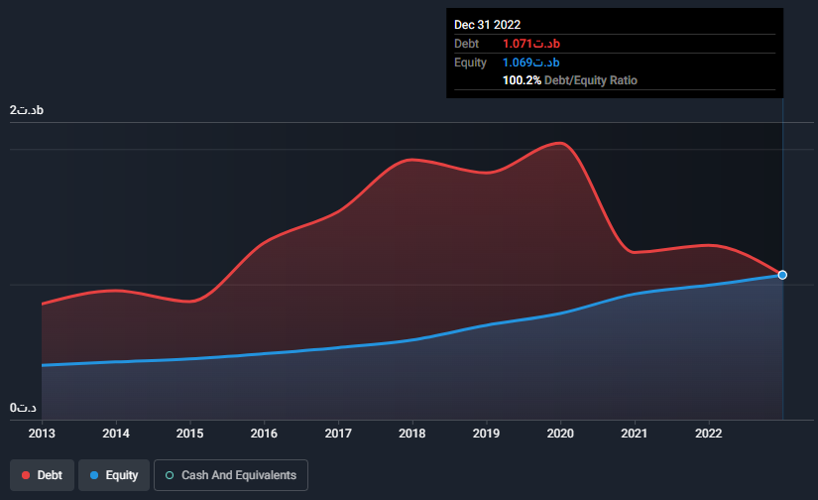
Attijari

Slide 38
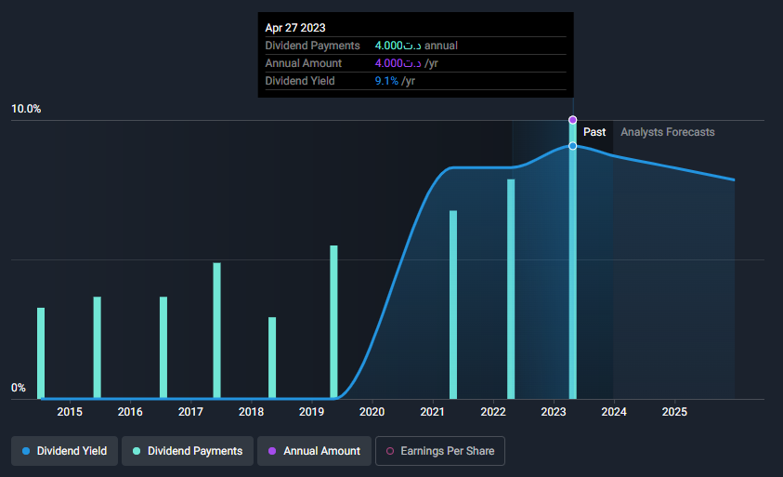
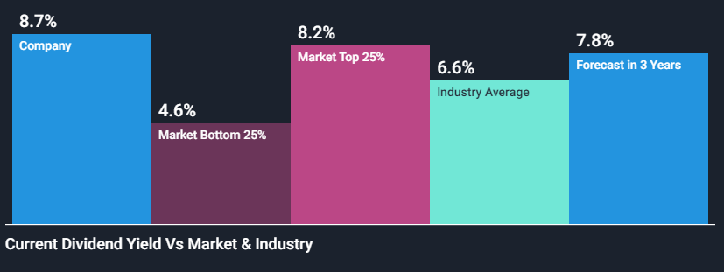
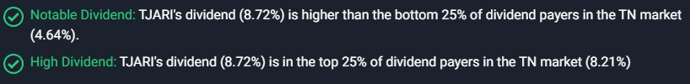
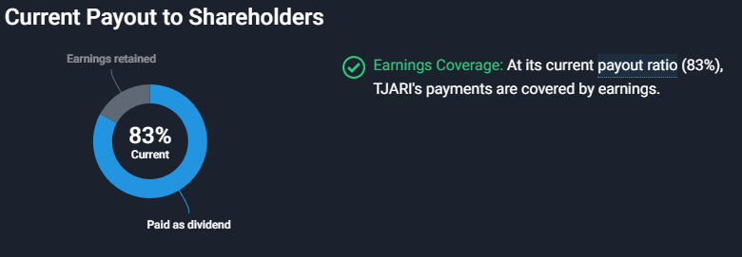
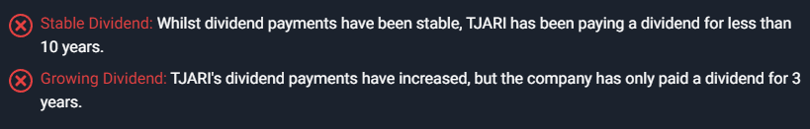

Slide 39
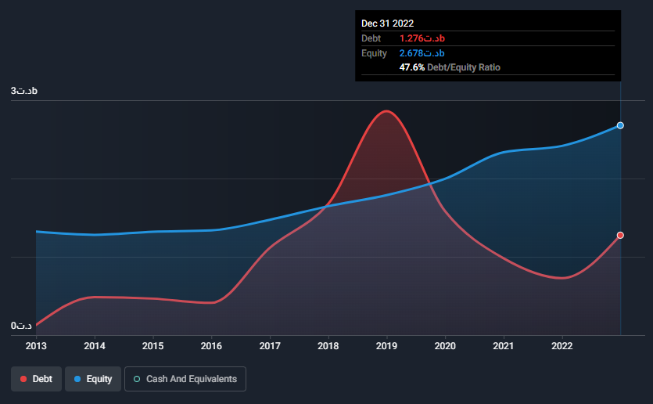
BIAT

Slide 40
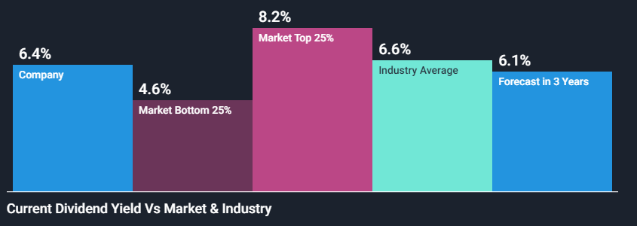
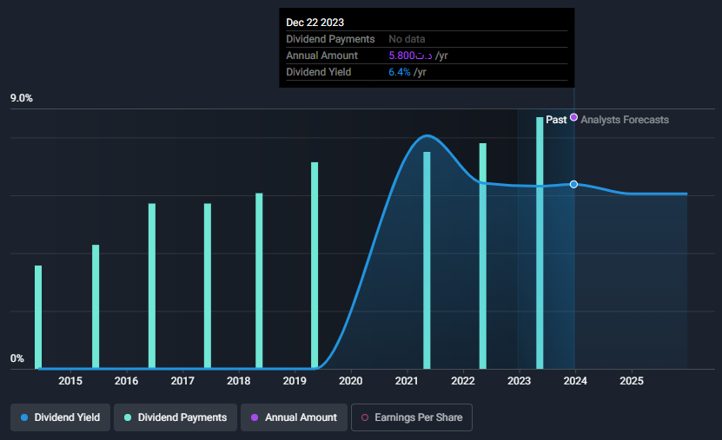
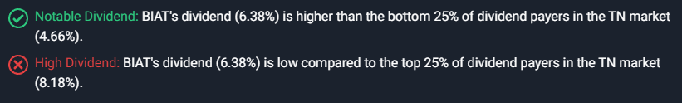
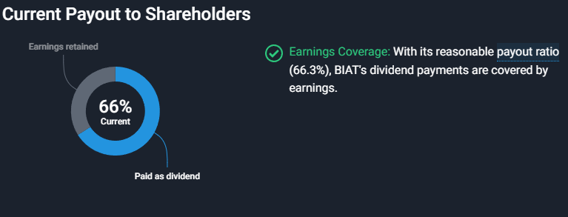
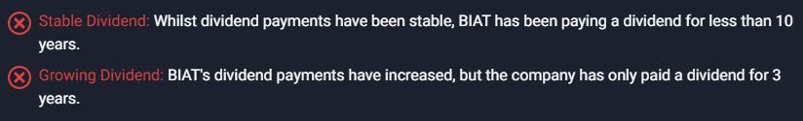

Slide 41
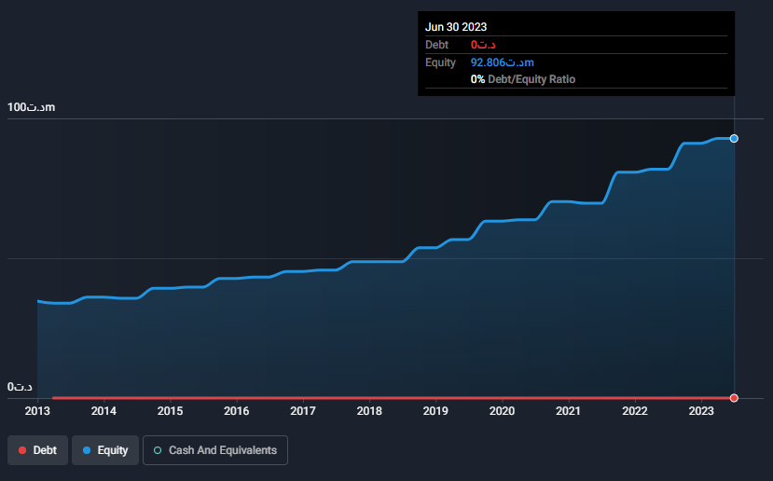
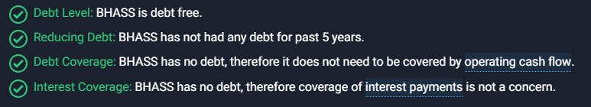
BH Assurances

Slide 42
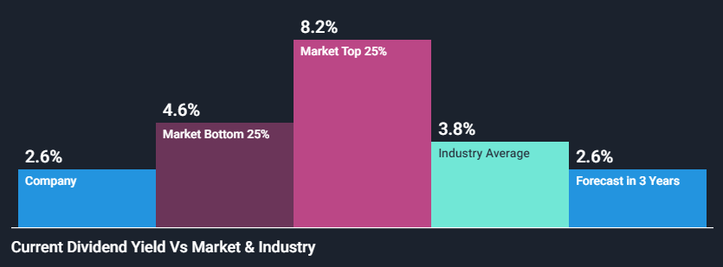
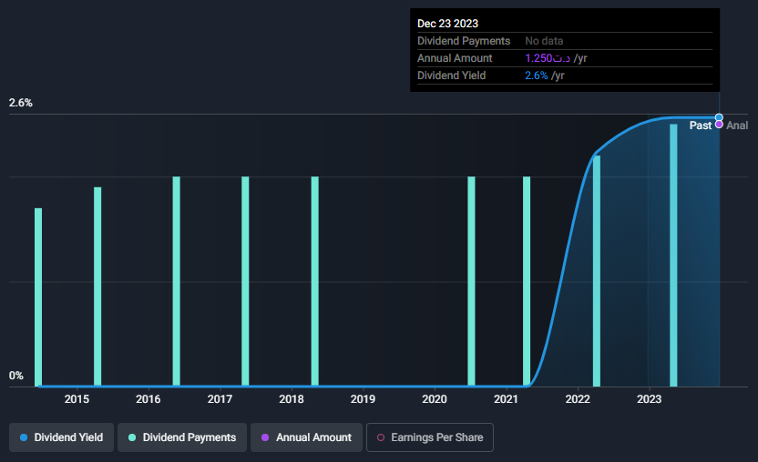
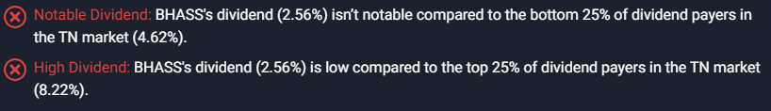
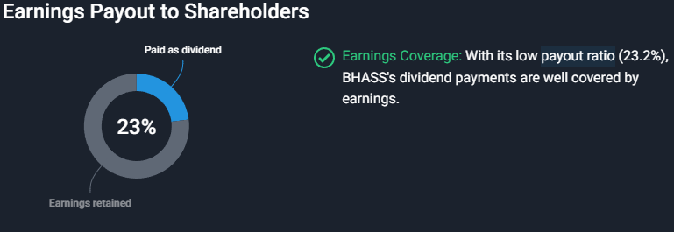
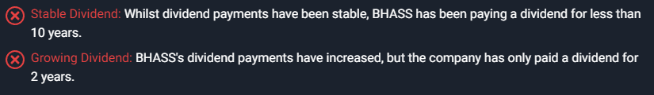
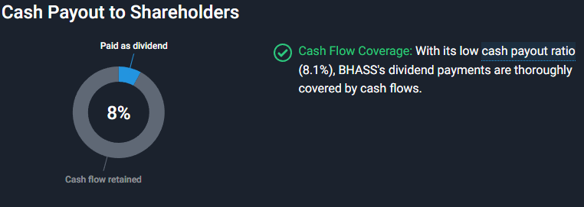

Slide 43
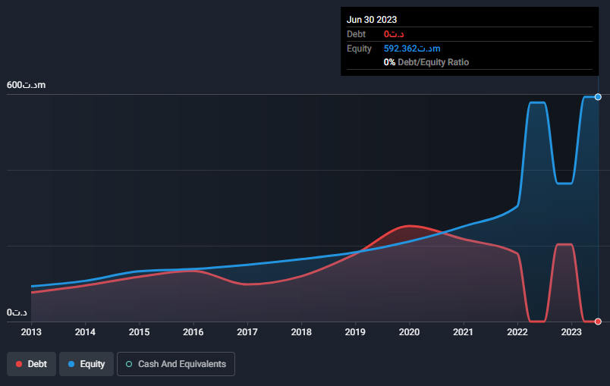
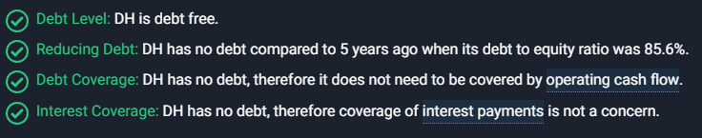
DELICE HOLDING

Slide 44
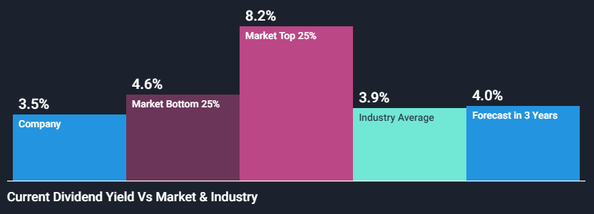
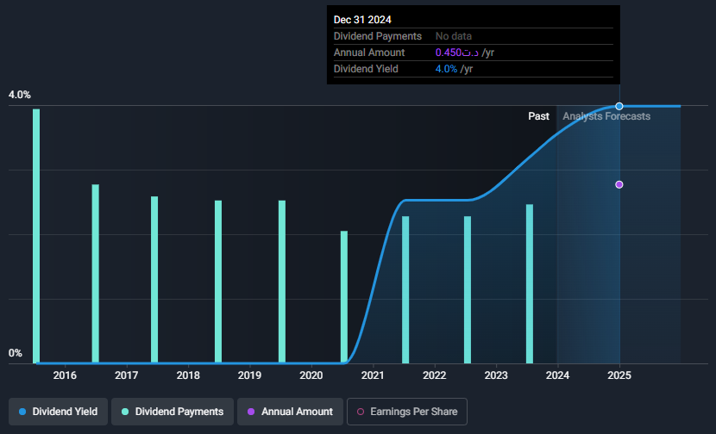

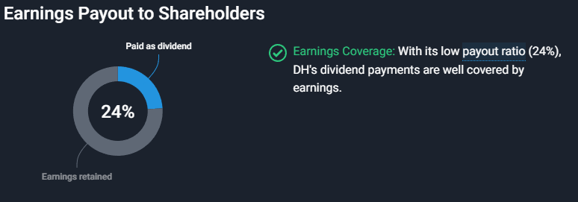
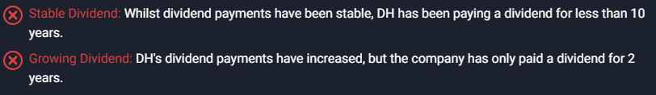
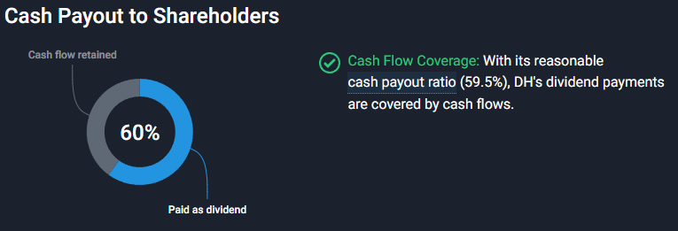

Slide 45
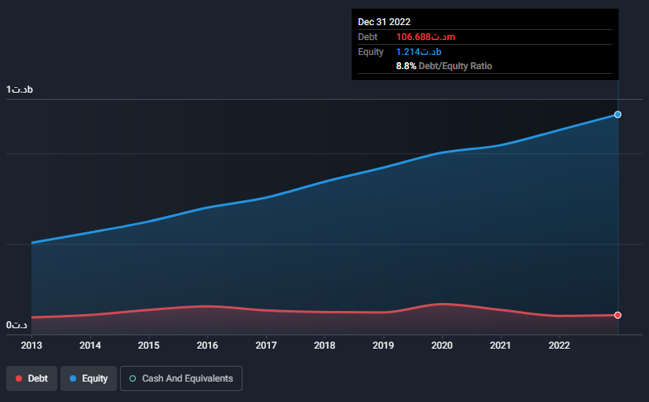

SFBT

Slide 46
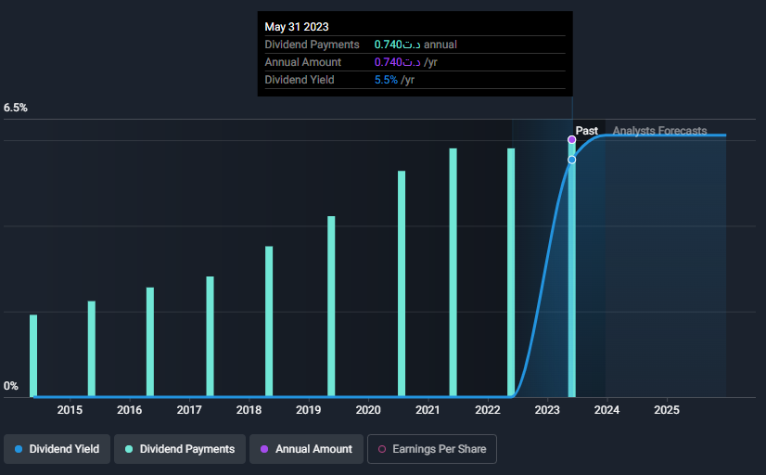
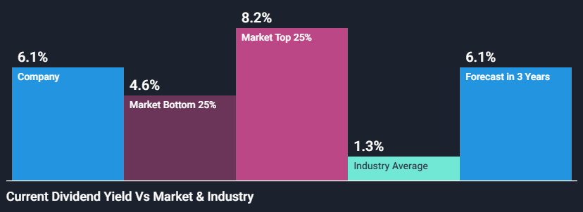
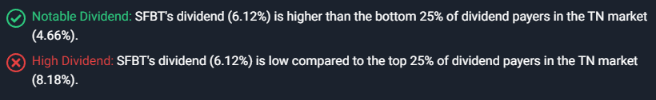
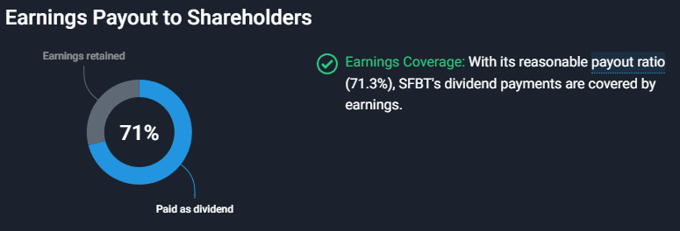


Slide 47
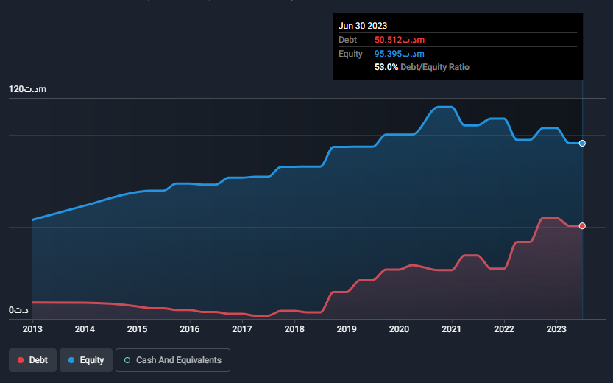
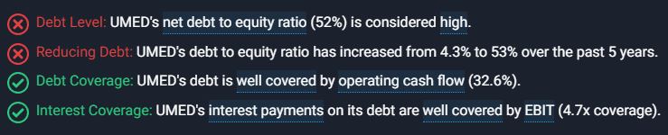
UNIMED

Slide 48
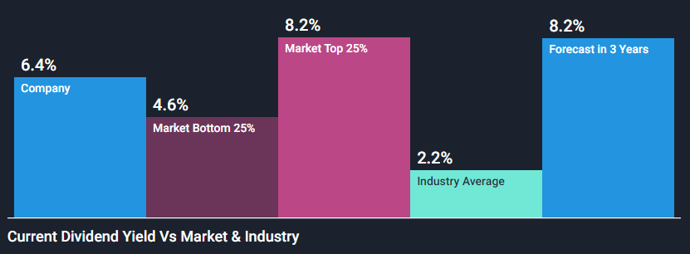
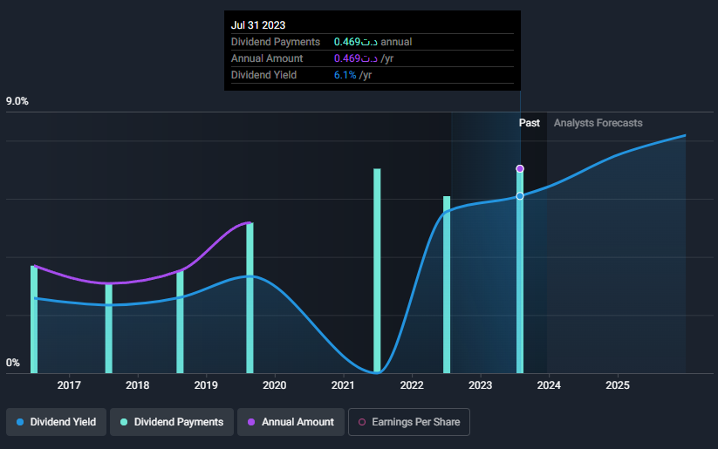
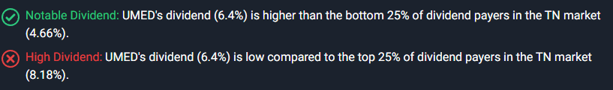
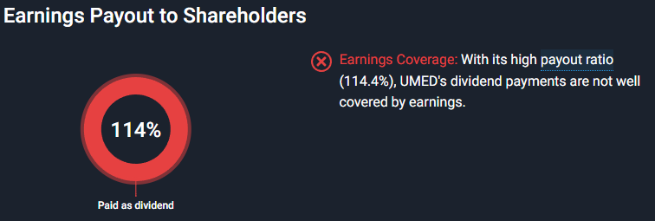



Slide 49


One tech holding

Slide 50





Slide 51
TECHNICAL ANALYSIS

Slide 52
In this section, we utilized technical analysis, employing Python and R for visualization, to discern distinctive patterns and track price fluctuations over time.
Notably, some stocks like DH exhibited clear and discernible patterns. The following examples highlight stocks with evident and visually apparent patterns.

Slide 53


Slide 54


Slide 55


Slide 56


Slide 57
Selecting, Monitoring, and Adapting for Optimal
Hence, our refined selection comprises more than 10 stocks, with two on standby to be considered for purchase if a stock underperforms.
In addition to these criteria, we assessed the individual performance of each stock during the period in which we buy and make rebalances, given our intention not to acquire them simultaneously.
The selected stocks for scrutiny include Attijari, OTH, SFBT, SAH, UNIMED, SOTUMAG, City Cars, DH, Poulina, Eurocycle, Smart TN, and Telnet.

Slide 58
WHEN TO PURCHASE
In this section, we employed Bollinger Bands (BB) buy and sell signal as a key reference for our buying and selling decisions, utilizing Python for analysis.
The visualization capabilities of Python streamlined the process, allowing us to focus on specific periods, particularly in December each year.
This approach provided valuable insights into potential trading strategies. For instance, when analyzing the Attijari stock

Slide 59


Slide 60

HOW DID WE PURCHASE ?
In addition to using Bollinger Bands as a reference for trading signals, we adopted a gradual buying approach instead of acquiring all shares at once. Recognizing the high volatility during the December period, as if each day presented, somehow, different market conditions, we implemented strategic rebalancing.
This involved selling stocks and repurchasing them at lower prices to make better returns and mitigate the impact of the market’s slight fluctuations.

